Slide 1

SELECTED _2

Slide 2
1)Cover Sheet
Faculty of Computer Science and Artificial Intelligence Helwan University.
Course Name: Selected Topics CS-2
Team number:16
ID | Names
202000004 | إبراهيم عبدالعزيز عبدالحافظ محمد
202000541 | عبدالرحمن هاشم سيدي سيد
202000741 | محمد بدر أسماعيل بدر
202000753 | محمد ذكى لطفي ذكى
202000777 | محمد عادل محمد سيد احمد
202000479 | طه سعيد شعبان عبد التواب

Slide 3

2)Paper details
a)
Authors name: Minhaz Kamal* , Fairuz Shaiara* , Chowdhury Mohammad Abdullah* , Sabbir Ahmed, Tasnim Ahmed, and Md. Hasanul Kabir.
Paper name : An Application for Arabic Handwritten Character Recognition Using Deep Learning
Publisher name: IEEE
Publisher Year: 24 Dec 2022

Slide 4
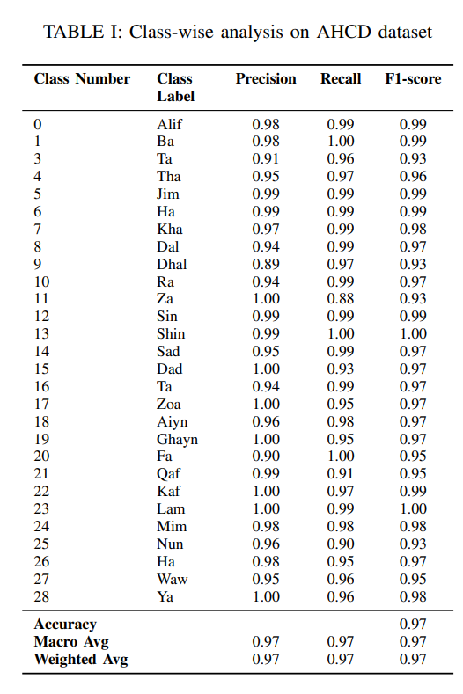
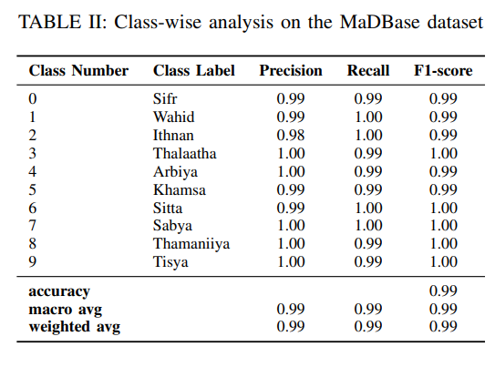
b)
Dataset used : HMBD and MaDBase.
Implemented Algorithm : CNN.
Results: The final result for the characters showed a test accuracy of 96.93% , 99..35% for handwritten digit recognition

Slide 5
3)Project Description Document
a) General Information on the selected dataset.
Dataset name : Arabic –Handwritten-Chars.
Link dataset: https://www.kaggle.com/datasets/rashwan/arabic-chars-mnist
Total number of samples: a training set(13,440 characters to 480 images per class) and a test set(3,360 characters to 120 images per class)
The dimension of the images:32*32
Number of Classes :28 class and 28 label

Slide 6
3)Project Description Document
b) Implementation details:
Ratio of training:99.94
number of images in training:9408
Ratio of testing:97.777
number of images in testing:3360
Ratio of validation:97.772
number of images in validation:4032

Slide 7
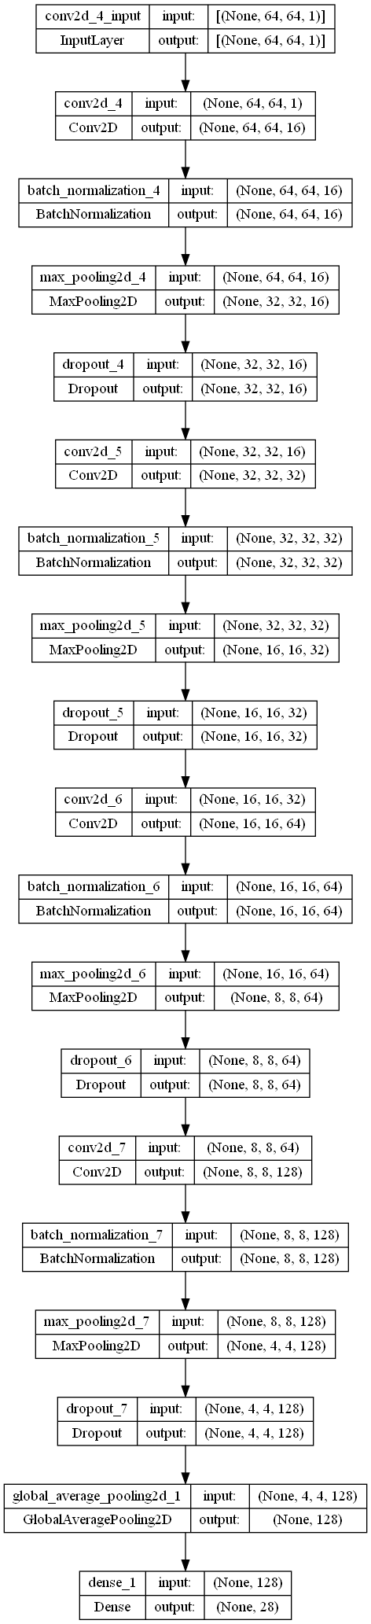
3)Project Description Document
Block digram:

Slide 8
3)Project Description Document
Hyperparameter used:
• Optimizer: Adam
• Kernel initializer: uniform, he_normal
• Activation: Relu,Softmax

Slide 9
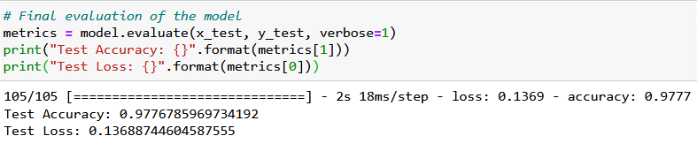
3)Project Description Document
c) Rersults details:
Testing accuracy:

Slide 10
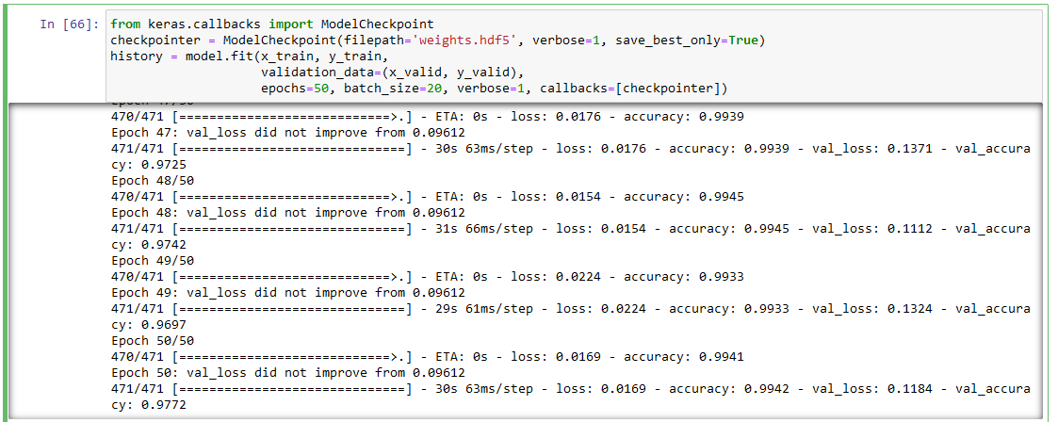
TRAINING MODEL 100 epochs to reach this accuracy in training and test

Slide 11
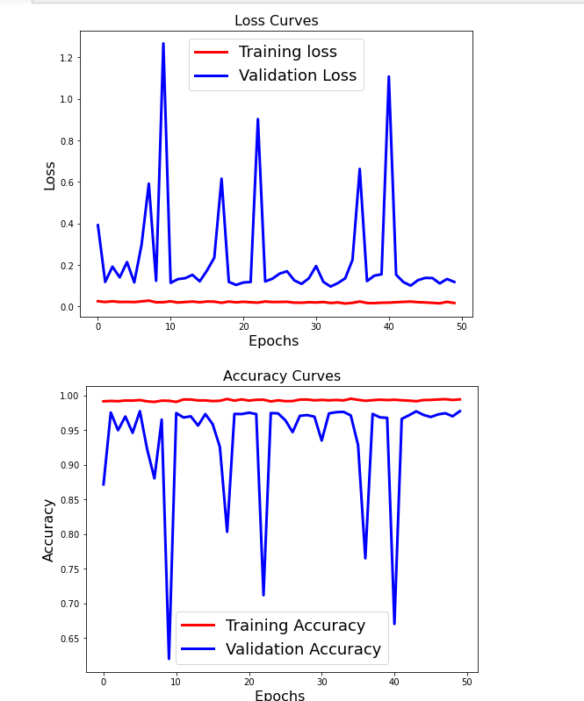
LOSS AND ACCURACY CURVES

Slide 12

Thank you
TEAM GAMED

